Slide 1
Year 7 Information Evening
Welcome to St Thomas More Catholic High School

Slide 2
Aims of this evening
Key Staff
Pastoral Systems and School day – Mr Flynn
Ethos and STRIVE – Ms Hagan
Transition – Mr Anderson

Slide 3
Pastoral System – Key Staff
Form Tutor
Head of Year 7 – Mr Rayson
Assistant Head of Year – Mrs Green
Assistant Headteacher – Pastoral - in charge of Key Stage 3 – Mr Flynn
Senior Assistant Headteacher – Pastoral – Ms Hagan
Deputy Head – Mr Henderson
Headteacher – Mr Watson

Slide 4
Pastoral System – Key Staff
Your child may receive additional support in school from the following staff:
Assistant Headteacher -SENCO – Mrs Swann
Associate SENCO’s - Mr Briggs and Miss Fairlamb
School Chaplain – To be confirmed
Learning Mentors – Mrs Forsten, Mr Wright, Mrs Collins, Mrs Barrett
Family Support – Mrs Leach
School Counsellor – Mrs Harbison

Slide 5
Pastoral System – Form Classes
There are 9 form classes in Year 7.
Each form class has approximately 30 students.
Form teacher, Head of Year/Ass Head of Year will usually see students through for five years from Years 7-11.

Slide 6
The School Day
The school day begins at 8.45am. Students should arrive in registration before the bell goes at 8.45am. There are 5 lessons.
Break time is at 10.00-10.20. Students who want a snack at this time should bring one from home.
Lunch is at 12.20-1.05.
The school day ends at 3.05 but Year 7 students are dismissed at 2.55 (buses).

Slide 7
School Lunches
Variety of meals are available – vegetarian/vegan
Lunchtime meals from September will cost £3.00
Payment:
  Cashless system – biometric (thumb print) or PIN
  Top up account using ParentMail
    Secure – available 24/7
    You will receive a registration email
    Machine in the Dining Hall
    Daily maximum spend of £5

Slide 8
Free School Meals
If you think your child is entitled to a free school meal we recommend you contact North Tyneside Council.
Cashless system – there is no way to distinguish between pupils who receive free school meals and those that do not.
Significant additional funding for every child who is receiving a free school meal.

Slide 9
Scholars Buses
Timetable is available on the school website.
Buses are considered to be part of the school day and we expect students to behave accordingly.
Please ensure that your child has a written note of the bus they need to catch at the start of term.
Staff will be on hand at the end of the school day to help direct students to the correct bus.
Update – Bus Pass – previously a bus pass has been universal to anyone who lives a certain distance from school. There are changes to this for September and will now be based on income. HOWEVER – it is still worth applying as the vast majority will still qualify.

Slide 10
Equipment
A reusable water bottle
Snack for break
Packed lunch/purchase food from the dining hall
School bag
Reading book
Pencil case including;
2 x black/blue pen
1x pink pen
1x pencil
1x ruler
1x rubber
1x calculator
Mobile phones are a prohibited item
Chewing Gum is a prohibited item

Slide 11
Uniform – Main School Uniform
White school shirt
Mid-grey traditional, tailored school trousers or a school skirt
School tie
School blazer
School jumper – optional
Black ankle socks, black opaque tights
Plain black traditional school shoes (not trainers, boots or sportswear)
If your child chooses to wear a coat then it must not be any kind of sports wear or hoodie.

Slide 12
Uniform – PE Kit
Polo shirt – black, maroon and amber*
Outdoor top – black and maroon*
Black tracksuit bottoms, shorts or leggings that have the school logo
All of the above are available from Emblematic
Black football socks
Trainers (shoes not boots)
Football boots (studs)
* Only one of these is compulsory

Slide 13
Uniform
No make up is allowed.
No unnatural hair colours are allowed.
No facial piercings are allowed. Only jewellery that should be worn is one pair of studs in the earlobe and a watch. This does not include smart watches.
No fake eye lashes.
No fake nails or nail polish.

Slide 14
Uniform
Available from Emblematic – North Tyne Industrial Estate, Longbenton.
It is recommended that you get your orders in as soon as possible.
Items available from Emblematic:
Blazer – £28.99-£30.99
Kilt – £19.99 - £24.99
PE Polo Top - £13.99-£17.00
PE Outdoor Top - £19.99/24.99
PE Tracksuit bottoms – 18.95-20.95
PE Leggings – 17.95-19.95
PE shorts – 9.99-10.99
Ties are available from the school office between 8am and 4pm - cost £6. This is only up to the summer holidays.

Slide 15
Curriculum
English | Maths | Science
Religious Education | French | History
Geography | Design Technology | Food Technology
Art | Textiles | Music
Physical Education | PSHE | ICT and Business
9 form groups
Maths – will be grouped based around ability
English and Science – small support groups
Other subjects – mixed ability
Technology – totally different groups than form classes
Homework will be set on Classcharts – Invitation will be issued in September
Student Handbook – available to students via Google Classroom and available on the Website
Enrichment Activities
Library

Slide 16
Ethos
St. Thomas More Catholic High School is a Catholic school, and as such we strive to follow the example of Jesus Christ in our work, worship and relationships.
Our aims are:
• To be a community based on Christian values, notably Love, Justice, Peace, Truth and Tolerance, and to encourage individuals in their commitment to these ideals.
• To provide a secure, welcoming and ordered environment in which individuals learn to value and respect both themselves and others.
• To give individuals the opportunities to develop their full potential as human beings, and to encourage and challenge them to do so.
• To encourage everyone to strive to do their best and to strive for the highest standards in all areas of activity. To help children grow into confident, open, resourceful young people with a sense of responsibility and of service.
Notes:
It’s important to share with you our Ethos and aims from the very beginning of your child’s journey with us because it underpins everything that we do.
We are unique from many other high schools as a Catholic High School and our Ethos is to follow the example of Jesus in our work, worship and relationships. We are a close knit community who very much live by the Christian values of love, justice, peace, truth and tolerance and these, like I say, are at the heart of everything we do.
Providing a secure and welcoming environment for your children to be part of is one of our key aims and by this being in place it means that they will be able to take advantage of all that is on offer in order to develop their full potential. We want everyone to do their best and be ready for whatever they may face in the world as they get older. To ensure that all of this is possible we do have expectations that we require students to meet every day and I’d like to share them with you so that you are aware of them before the children start in September.

Slide 17
STRIVE – 6 Behaviours for Learning
We want our students to Strive in all areas of school life.
In order to do so we have high expectations and so students should strive to meet our 6 behaviours for learning every day:
S – Standard of Uniform
T – Timeliness
R – Respect
I – Independent Learning (Homework)
V – Value Learning (Classwork)
E - Equipment

Slide 18
STRIVE
Classcharts
You can see when your child is awarded positive points.
You can also see if staff have issued any negative behaviour points.
Detentions
Independent Learning (Homework) is set on Classcharts – please monitor this.
Notes:
We aim to recognise and reward our students achievements and therefore they will be awarded positive points which they can use to purchase items in our Classcharts shop – this is very popular.
- For those who don’t meet the basic expectations you can monitor this as they may receive negative points – rare in Year 7 – detentions - rare

Slide 19
Home School Partnership
Key Areas:
Ensure regular and punctual attendance
Homework – monitor Classcharts and keep an eye on deadlines
Attendance to Parents Evenings
Supporting School Procedures
Inform us of anything that may have an impact on your child in school

Slide 20
Contact with School
Invitation to meet your child’s form tutor during the first half term
Interim Report – Spring Term
Final Report – written comments – July
Parents Evening – March
Any concerns – contact Mr Rayson or Mrs Green by telephone – 0191 2588340 – Appointments must be made in advance.
Parentmail
Classcharts – key to keeping in touch on a daily basis. You can monitor both positive and negative points issued by staff. Homework is set on Classcharts.
Absences should be reported on Arbor.

Slide 21
Attendance
High standards, 96%
Please encourage good attendance
Attending school is a key element of allowing students to develop both academically and socially. This is ultimately helping them to Strive.
In the event of an absence:
  Use Classcharts to contact school to inform us of the reason for absence
  If your child is absent for more than one day then please inform us each day
  Any leave of absence, including holidays, needs to be requested in writing, in advance. Only authorised in exceptional circumstances. The leave of absence form is available on the school website.

Slide 22
Medicines in School
Written consent
Individual Healthcare Plan (IHP)
  Usually for complex or serious conditions, for eg, asthma, epilepsy, anaphylaxis, diabetes
  Please contact the Medical Conditions Coordinator at school if you think you may need an IHP
Administration of medication form
Original packaging with dosage and administration information.

Slide 23
Transition Days
Thursday 3rd July and Friday 4th July, 8.45-3.05
Students to make their own way to STM
Primary school uniform
Pen, pencil, ruler, water bottle
Meet key staff and their form class
Assembly, taster lessons including a liturgy
Ice breaker activities, tour and activity linked to the liturgy

Slide 24
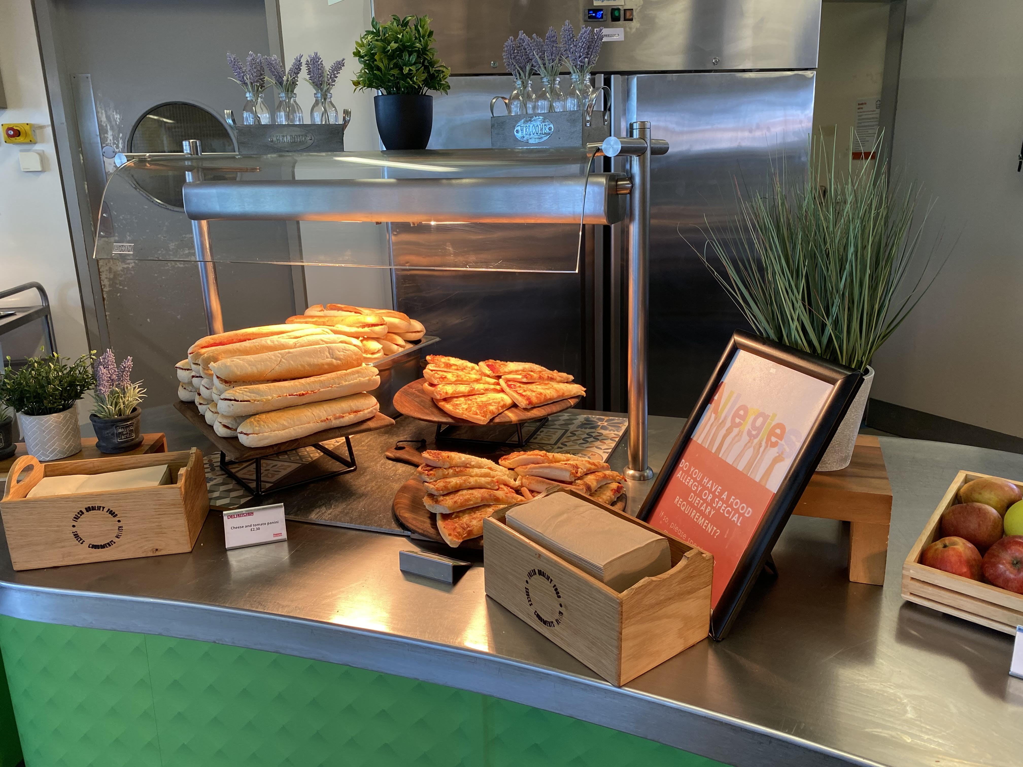
Transition Day
Breaktime – bring a bottle of water/small snack.
For transition, lunch will be provided for free for all Year 6 students. 12pm
The menu will be emailed to all parents/carers.
Alternatively, pupils can bring a packed lunch

Slide 25
Transition Day
Students enter and leave via the service road
  Please do not use the school car park for drop-off/collection.
Scholars buses
  Staff will be around at the end of the day to help ensure students leave the site safely and catch the scholars buses, please ensure your child knows which bus to catch.
Medical
  If your child has a medical condition that may require any medication to be taken during the two transition days please see me briefly at the end of the presentation.
Absence
  If your child will be absent on the transition day please report their absence to both the primary school and STM.

Slide 26

Registration and Consent Form
Please ensure that you have completed the online Student Registration and Consent Form.
The link has been emailed to parents/carers, and is also available in the Transition Area of the website.

Slide 27
Preloved Uniform Shop
Tuesday 8th July
5-7pm in the school hall
Selection of good condition, preloved school uniform including blazers, skirts, trousers, shirts, PE tops and coats
Stocks are limited but anyone can pop in a pick up items
Free of charge

Slide 28
Coffee Morning
The Learning Support Department is hosting a coffee morning for all parents/carers of students with special educational needs on Tuesday 9th July, 9-10am, as a chance to learn more about provision for SEND and also to meet the team. A Google form will be sent out - please reply to confirm if you would like to attend.

Slide 29
Breakfast
We all know the importance of breakfast so free bagels are available every morning before school in our dining hall. These are available to all students.

Slide 30
Connect Mental Health Team
We work with the Connect Mental Health Team
You will receive a flyer with more information in Septmber.

Slide 31
People to see
Medical Issues – See Mr Anderson
SEND – Miss Fairlamb/Mr Briggs
Pastoral –Mr Rayson, Mr Flynn, Ms Hagan

