Slide 1
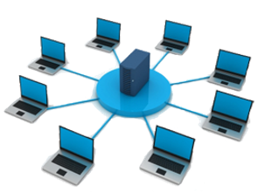
Component 3 Learning Aim A Modern Technologies - A1 Modern Technologies
Communication Technologies - Setting up Ad Hoc Networks
Key Vocabulary
Bluetooth ​ | A short range technology (10 metres or less) that can connect multiple devices. e.g. mobile phones & speakers
Ad hoc Network | A wireless network that does not rely on fixed hardware such as routers in wired networks. ​
Personal Area Network | Used for data communication between devices.​
Tethering | Where a smartphone acts as an access point, allowing other devices to connect to it to share its mobile broadband connection to the internet.​
Personal hotspot | Using a phone’s internet connectivity to access the internet from the laptop.​
PIN | Acronym meeting Personal Identification Number​
Encrypted | Information or data has been converted to a type of code that cannot be understood without a translation key.​
USB | Universal Serial Bus. A standard for connection sockets on computers, connecting devices such as mice, keyboards, printers, external hard drives, etc.​
Insecure | A connection where data maybe intercepted by other users.
Streaming | Data is sent to your device in a continuous flow when connected to the internet.
Examples of ad hoc networks: PAN Open Wi-Fi Tethering or Personal Hotspot
Benefits​ of ad hoc | Drawbacks​ of ad hoc
They are scalable | They are less secure.
They are flexible ​ | They have a reduced speed.
They require limited setup. | The network can become unorganised.​
Traditional vs ad hoc networks
Traditional networks are made up of several PCs, routers and other devices that are connected using cables and wires. | Ad hoc networks are networks that do not require wires or cables, Modern technology has made it possible for organisations to connect devices when they are needed.
Issues affecting availability:
Rural vs city locations
Developed vs developing countries
Available infrastructure
Mobile network coverage
Blackspots

Slide 2
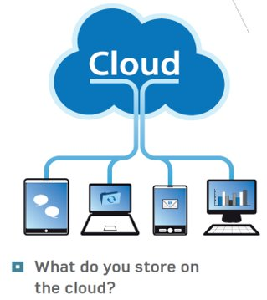
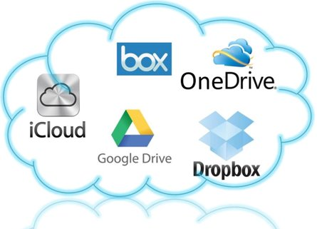
Component 3 Learning Aim A Modern Technologies - A1 Modern Technologies
Features and Uses of Cloud Storage
Key Vocabulary
Server | A computer that delivers data between machines that are connected to a local network.​
Downloading | A file or document can be used when you are not connected to the internet. ​
Uploading | A file or documents can be used by you or other with access when connected to the internet. ​
Synchronising | Is when files held on two devices are updated to make sure that both have the same content.
What is cloud storage?
Files and folders are stored remotely rather than on a PC or device.​
​
The files are stored on servers so they can be accessed via the internet.​
When you want to access the media, the data is downloaded or streamed to the device you wish to use it on.​
It remains in the file in the cloud unless you delete it. ​
Data on your device can also be uploaded to the cloud.
When is cloud storage available?
Only when there’s an internet connection. ​
If the connection is broken access will be terminated. ​
The speed of the connection will impact file upload speed and download stream speed.
If there is a suitable connection, data and files in the cloud can be accessed 24/7
Features and usage of cloud storage:
ISPs often give users a cloud storage allocation as part of a phone or tablet contract
Scalability – you can pay for extra storage.
Services can also be provided by third parties
Cloud storage is useful for storing backups of your files. Copies of the files are made on different servers so that they are protected if attacked or in case of a natural disaster such as fire or flood​
You can synchronise with the cloud.
What can be stored in the cloud?
Images/Videos
Emails
Contact info
App Back Ups
Cloud Storage Providers:
Benefits​ of cloud storage | Drawbacks​ of cloud storage
You can access your data from any device that has an internet connection and a web browser. ​ | If there is no connection you can not access your data. Slow connection also will hinder your experience. ​
Scalable – You can purchase more storage space easily. ​ | Some providers offer limited storagespace for free, but additional space can be expensive​
The data and its security is managedby the provider. ​ | You have no control where or how your data is stored. You must trust the provider to keep your data confidential. ​

Slide 3
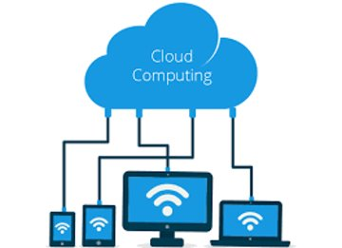
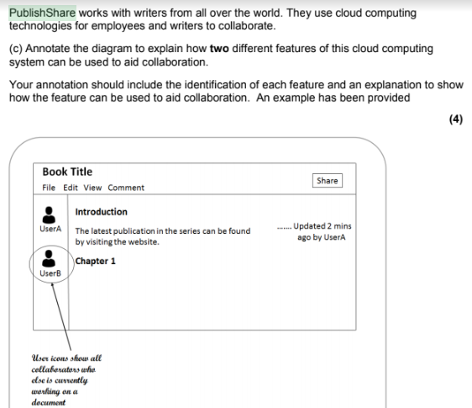
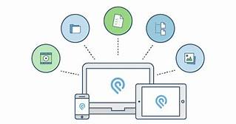
Component 3 Learning Aim A Modern Technologies - A1 Modern Technologies
Features and Uses of Cloud Computing
There are two main ways of accessing online applications.​
Web-based applications which run entirely through browsers​
Cloud-based applications where your local services and cloud service work together to provide a service.
Example exam question
Benefit​s of online applications | Drawbacks of online applications
No installation​ | Must have a reliable internet connection.​
Cost effective​
No need for updates​
Accessible from anywhere​
Direct access​
What is file sharing?
Two or more people can work on the same document at the same time.
Benefits of collaboration tools
Collaboration tools allow users to:​
Add comments to documents​
Track changes made to the document​
Use services such as live editing​
Use chat facilities to discuss proposed changes to documents, plans or drawings before these changes are made in the file.

Slide 4
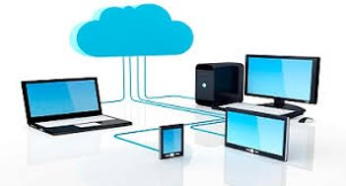
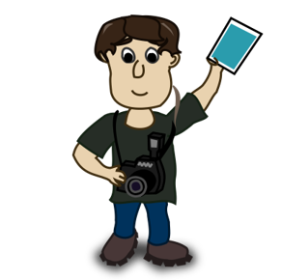
Component 3 Learning Aim A Modern Technologies - A1 Modern Technologies
Selection of platforms and services
Key Vocabulary
Stakeholders | These are people with a financial interest or investment In a business or organisation
Downtime | A period of time when a computer and it’s services are unavailable.
Geo-data | Geographical information stored in a way it can be used by your device. i.e. your location.
The most common platform types:
​
Desktop client​
Notebook​
Tablet​
Smartphone​
Features that affect platform selection:
Screen size​
Portability​
Processing power​
RAM​
Storage capacity​
User interface (keyboard, mouse, touchscreen, voice control, etc)​
Operating system (Apple iOS, Microsoft Windows, Android etc)
Example Exam Question
A photographer/ journalist at a football match takes hundreds of pictures during a game. They will need to select the best picture and write a story before the deadline 2 hours after the game has finished.​
Using the features below which device would be most suited for his job?​ [4]
Screen Size​
Portability (how easy it is to move around)​
Storage capacity​
User interface
What might an organisation consider when selecting a cloud platform?
Security methods​
Amount of storage space​
Ease of use​
Frequency of updates​
Accessibility
Cost
Interface design

Slide 5
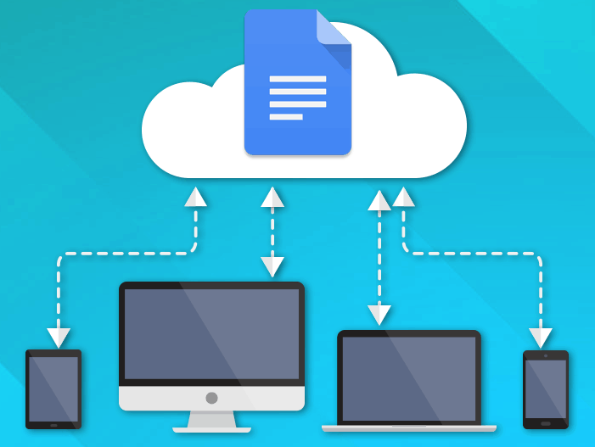
Component 3 Learning Aim A Modern Technologies - A1 Modern Technologies
Using Cloud and Traditional Systems Together
Notifications
Cloud systems will send you notifications based on your activity, or what team members with shared access to the same folders you are working on.
Key Vocabulary
Synchronisation | Process of making two or more data storage devices or programs (in the same or different computers) having exactly the same information at a given time.
Synchronising content over devices
Sometimes applications and files are located on an organisation’s own system or user’s PC, but they could be in the cloud. ​
​
Most organisations and many individuals use a combination of both.​
​
When using a combination of both, synchronisation is particularly important to make sure that all versions of the files are exactly the same. ​
e.g. A sales person has files stored on their work PC, which are then synchronised to their laptop and are available via a smartphone.
Syncing Apple devices using iTunes:
A user can choose to automatically back up their device to the cloud, and to only sync ticked songs and videos (rather than all content) over Wi-Fi. ​
If the user has several devices that access the same cloud content, all the devices would be updated.
Online/Offline Working
Many workers are not necessarily in the office every day, they may work in another geographically remote office, at home, or while travelling.
When working offline, files can be saved in a shared area.
They will not be saved immediately in the cloud, but copies of the files are also saved offline on the user’s device. When internet access become available, the files will be automatically synced.
Connecting to the internet:
Most laptops connect to the internet using Wi-Fi.​
If no Wi-Fi connection is available, it may be possible to tether laptops to smartphones.​
​
In this way the phone is being used as a personal hotspot, which allows the laptop to connect to the internet via the phone.​
​
If no internet connection is possible, the user will work offline and upload or synchronise the content with the relevant systems when an internet connection is available.
Example exam questions:
Explain why you should sync content between devices and systems.
Explain how a personal hotspot helps with synchronisation.

Slide 6
Component 3 Learning Aim A Modern Technologies - A1 Modern Technologies
Choosing Cloud Technologies
There are different factors that organisations will have to consider when choosing cloud technologies that will work for them and their situation. Some of these include:
The Disaster recovery policies
Data Security
Compatibility issues
Data security
Most cloud computing companies will have several strategies in place to protect the security of their customer information.
Any breach could damage their public image and lead to serious consequences for the organisation such as loss of customers and legal action.​
​
As a result, the cloud technologies service provider will employ a range of security measures, including keeping their digital systems protected at their large data centres, where many computers are located under one roof.
They will also control access to data and are storing data safely and in an encrypted format where necessary.
Broken or outdated digital systems will be appropriately disposed of.
Disaster Recovery Policies
Most cloud technology services offer backup services as part of their set-up costs.​
​
Automatic backing up is usually carried out at quiet periods.
​
A disaster recovery policy is typically designed to set out the actions that will need to take place after a disaster, for example an attack or natural disaster, such as a fire or flood, to restore an organisation’s services and processes as quickly as possible.
Compatibility
Compatibility isn’t usually an issue for organisations when choosing cloud technologies.
Most cloud technologies use well-supported and documented operating systems such as Microsoft Windows or Linux.
This should enable organisations to run any combination of popular applications and services without an issue.
Cloud technologies can generally be relied on to:​
​
Be unaffected by attack of disaster as they are located away from the organisation. ​
Have appropriate nightly backups - in the event of a disaster very little data is lost. ​
Be protected by good security.
Benefits​ of disaster recovery policies | Drawbacks​ of disaster recovery policies
The can reduce the amount of time it takes to recover following a cyber security disaster.​ | It is not always possible to think of every single risk that could occur before an attack iscarried out.​
The set out the roles of each person so everybody knows what to do following an attack.​ | Once the policy has been created, it needs to be continually updated to ensure new threats have been accounted for. ​

Slide 7
Component 3 Learning Aim A Modern Technologies - A1 Modern Technologies
Maintenance, Set-up and Performance Considerations
Performance considerations
A fast broadband connection is required or the responsiveness to user requests and synchronisation of devices may be slow.
Service or storage needs to satisfy all the requirements of the organisation.
May need to be scalable.
Software must be responsive to users.
Proposed cloud software will run on any devices that are used by employees.
Key Vocabulary
Virtual Machines | Software applications that are designed to behave as if they are a whole computer.
System administrator | A person who is responsible for a technology to make sure they are maintained and reliable.
Spam | Electronic junk mail, usually sent with a commercial purpose.
Downtime
Downtime is usually limited on a cloud computing solution.
Downtime of just a few minutes can be a serious issue for organisations that rely on a continuous 24-hour service.
Downtime can be caused by:
Interrupted internet connectivity,
Cyberattacks,
Updates
Maintenance of cloud computing solutions
Usually automatic because solution providers regularly update processes, which keep the virtual machines (VMs) up to date and make sure that the solutions stay healthy and secure.
Organisations may add their own services and updates as part of their security policies.
Most cloud computing solutions have web-based dashboards that can monitor activity levels, such as CPU usage, disk space and network communication.
Additional settings can email the organisation’s system administrator about potential problems, including high CPU usage, low available disk space etc.
Benefits​ of cloud technologies | Drawbacks​ of cloud technologies
Technologies are generally secure ‘out of the box’​ | So services may not be allowed. E.g. mail servers.​
They are up to date​ | A good internet connection is required. ​
Automatic backups may be created as part of the plan.​ | Organisational data is stored on the internet. ​
Solutions can be depilated easily​ | Pricing plans maybe more expensive than expected. ​
Solutions can be re provisioned quickly and without fuss.​ | Incompatible product may cause issues with data transfer. ​
Technologies may require less monitoring.​ | ​
Technologies may require less manual intervention. ​ | ​
Disruption of service isgenerally rare.​ | ​
Set up Considerations
Setting up a server requires​ | Setting up a cloud computing VM solutions requires. ​
Hardware purchase​ Hardware build or customisation.​ Operating system installation and configuration​ Applications and services installation and configuration​ Protecting from external threats.​ Test network connectivity. ​ | Selecting the cloud computing solution provider. ​ Creating an account and payment info. ​ Select type of cloud computing solution required.​ Selecting operating system and role of solution​ Deploying the device​ Performing additional configuration as required. ​

Slide 8
Component 3 Learning Aim A Modern Technologies – A2 Impact of Modern Technologies
Collaborative Technologies
Key Vocabulary
Version Control | Records changes to documents and files over time so that all versions can be recalled if needed.
Collaborative Technologies
Collaborative technologies enable staff to work together more effectively, allowing them to communicate and share information and documentation more easily.​
​
There are lots of technologies and software to help employees to communicate and collaborate.​
​
e.g. employees on different locations could work together on the designs for a new product, working in the same files at the same time.
Type of collaborative technology​ | Examples​ | Uses​
Interoffice chat programmes​ | LiveChat, Office Chat​ | Useful for answering business questions more quickly than through email​
Conferencing software​ | GoToMeeting​ | Used to support meetings without employees having to travel​
Project support technologies​ | Google Drive,DropBox​ | Support document sharing​
Project support technologies​ | FlockDraw​ | Enables team members to edit images simultaneously in real time​
Benefit​ of collaborative technologies | Description​
Global and multicultural workplace​ | Can help build relationships between people of different ages, gender, religion or culture.​ Leads to increased creativity and diversity in the workplace. ​
Inclusivity​ | Technology has provided functionality to help those who have limitations or disabilities.​ e.g. people with visual impairments can work on the same documents as people with no impairment by using software to enlarge the text.​
24/7/365​ | Services or facilities open 24/7/365 e.g. Internet content is available 24/7/365 – users are able to access pages at any time of the day or night.​
Team flexibility​ | Teams who work in different locations, countries or time zones can use technologies that allow them to share information and to contribute to projects from remote locations and at different times of the day.​ The working day can be lengthened e.g. one team can finish as another team in a different time zone begins.
Version Control
If several people are working on the same document, they could each save their document onto their computer, which would create several versions of the same document.​
They could also overwrite each other’s work.​
​
One way to overcome this is to use version control which can have the following features:​
Workflow – only one person can work on a document at a time. ​
One person at a time has edit access, the other people only have read access.​
History – a of what has been changed and who has changed it is kept.​
You can see the changes that have been made and then agree or disagree with them.

Slide 9
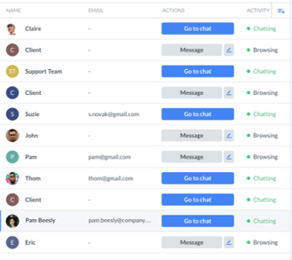
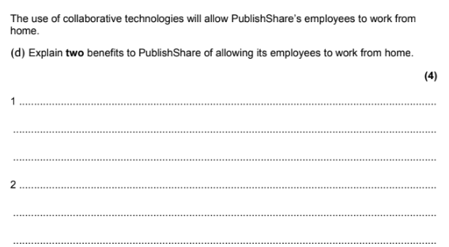
Component 3 Learning Aim A Modern Technologies - A2 Impact of Modern Technologies
Using Modern Technology When Managing Teams: Communication and Collaboration
Tools for collaboration
Modern technologies have made it much easier for managers to monitor the activities of their teams. ​
​
There are many tools that can be used to promote collaboration e.g. BaseCamp.​
These tools include several features, such as:
To-do area,​
Message board,​
Schedule.
Communicating as a team
Many organisations used chat programs to help staff in different departments or locations have a quick discussion.
One of the main benefits of this software is that you can see which of your colleagues is online, so it is clear who can be contacted. ​
Other available settings include “busy”, “unavailable” or “offline”.
Benefits of using collaborative and communication software to manage teams:
Storing and managing relevant working files in a single location.​
Ensuring that the file being worked on is the most up to date (as there is only one working copy of the file).​
Archiving previous versions of the file.​​
Using features of the software to allow team members to work on files at the same time.​
Communicating with the whole team simultaneously.​
Providing group support by the manager.​
Saving discussions (in case they are needed later).
Example Exam Question

Slide 10
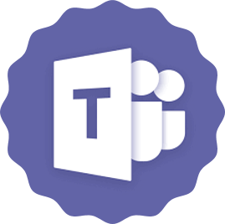
Component 3 Learning Aim A Modern Technologies - A2 Impact of Modern Technologies
Using Modern Technology When Managing Teams: Scheduling and Planning
Key Vocabulary
URL | stands for Uniform Resource Locator and is the address of a page on the World Wide Web.
Setting up a team
You can set up a team by inviting team members using their email address. ​
The team member is then notified and is given a URL and password to access the system. ​
When you invite users you can assign a role to them which will determine their level of access to the system.​
To add activities to the project you use the calendar function.​
Each participant then receives an email notifying them of any additions or changes to the calendar.
Scheduling and Planning
When you create a new project in planning software you can set a start and end date and it will automatically calculate the number of days involved.​
​
When managing teams, you could use project planning software to allocate tasks and control the schedule.
Benefits of using scheduling and planning software to manage and work within teams
Benefit​ | Description​
Access​ | Files and folders can be stored in one place so that all members of the team canaccess them.​
Tracking​ | Project managers can track progress and monitor the activities of teammembers.​
Version control/archive​ | Older versions of documents can be archived to ensure the documents being used are always the most recent ones. The archive is a file of all the previousversions of documents.​
Timelines and deadlines​ | Project deadlines and key milestones can be automatically synchronised with team member calendars.​
Communication andcollaboration​ | Software automatically allows for variations in time zones. This enables workers in different time zones to see when they need to do tasks in their own time zone​

Slide 11
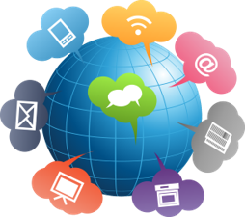
Component 3 Learning Aim A Modern Technologies - A2 Impact of Modern Technologies
Communication with Stakeholders
Communication Platforms
There are lots of communication platforms available, for example:​
Email,​
Social media,​
Text messages
Communication with Stakeholders
Organisations use a wide selection of communication technologies to connect with their stakeholders, from their corporate websites to social media platforms such as Facebook.
What is a stakeholder?
An organisation’s stakeholders include:​
Customers,​
Employees,​
Suppliers,​
Anyone else with an interest in the organisation.
Technologies for Communication
Channels​ | Description​
Websites​ | Provide a range of content, including information on products or services, prices, stock information and special offers so that customers can buy items online.​
Social media​ | Organisations can communicate in a much more relaxed way e.g. customers can ask for advice about a product.​
Email​ | More formal method of communication that has largely taken over from letters as the email is received almost instantly.​
Voice communication​ | Brings people together without them being in the same place. Can be live video as wellas audio. ​ This technology is often used to deliver training. The presenter can display presentationslides on the screen and participants can hear the presenter speak.​
Live chat​ | Some organisations offer technical support and customer service using live chat, where a text messaging app is used to support a conversation.​ Users usually have to log into their account to access this feature.​
How to choose the right communication technologies
Organisations must think carefully about which communication channels they should use in different situations to share information, data or other media. ​
Communications can largely be classified as either private/direct or public.
Private Communications | Public Communications
Communications between specific individuals.​ Only the people involved should be able to see the messages.​ ​ For example:​ Customer queries, such as order/payment information or requests for payment​ Customer payment details, including account details and payment methods​ Customer contact details, such as phone numbers or changes of address | Anyone can see the information that has been communicated.​ ​ For example:​ Product information, such as special features,​ Price reductions and other special offers,​ Advice on using a product.

Slide 12
Component 3 Learning Aim A Modern Technologies - A2 Impact of Modern Technologies
Accessibility and Inclusivity
Key Vocabulary
ALT Text | is alternative text that describes an onscreen image for users with visual impairments.
Interface Layout
The layout of screens also contributes to inclusivity and accessibility of web content.​
​
The content should be simply laid out with clear differences between the sections, with simple input and navigation controls that allow all users to easily interact with what is onscreen.​
​
The screen size affects what can be displayed and how it is displayed.
Interface Design
Organisations must think about how a website looks when it is viewed on different devices.​
The screen size affects what is visible and how it is displayed.​
Websites that do not adjust for different devices are known as non-responsive websites.​
​
For example, the Amazon website.​
Amazon’s solution is to provide apps for different devices to make sure their content looks its best on any device.​
They also have a mobile website that reflects the app design.
Accessibility and Inclusivity
Computers should be capable of being accessed and used by everyone, but some users have physical challenges that make aspects of computer use difficult or impossible. ​
Technologies that help users overcome some of these challenges are becoming increasingly available.
Accessibility Features
Most operating systems have built-in accessibility features, such as magnifiers, the option to change the colour schemes and even to use the computer without a display, mouse or keyboard.​
​
Other accessibility tools available include:​
Screen readers – which read the content of the screen to the user.​
Software that converts speech to text​
ALT text – allows the addition of text-based description of each image on a website for the benefit of blind or partially sighted users.
Inclusivity
Inclusivity is about the different ways to involve employees who have useful skills to contribute, but who are not able to work in the traditional way ​
e.g. someone recovering from an operation who is not able to drive to work yet but could work from home.​
​
Organisations can allow their employees to work more flexibly permanently.​
​
This could be by allowing them to work hours that suit their childcare commitments or to choose working hours and locations that suit them.

Slide 13
Component 3 Learning Aim A Modern Technologies - A2 Impact of Modern Technologies
How Modern Technologies Impact on an Organisation (Part 1)
Key Vocabulary
Distributed Data | Split into lots of bits and stored in different places.​
Dispersed Data | Multiple copies of the same data in different locations​.
Impacts of infrastructure on an organisation:​
Costing what is needed to buy and set up services​
Training for staff​
Implementing and testing time for the technology before staff use it in their work​
Maintaining technology – if software is not updated it may not work correctly​
Running costs of hardware e.g. printer ink​
Implementing a strategy to ensure that data is backed up and secure​
​
Managers must weigh up the costs of technology against the benefits it will bring. ​
Benefits and Drawbacks of Technologies
Technologies​ | Description​ | Benefits​ | Drawbacks​
Communication technologies (devices)​ | It is now common practice for managers to be issued with laptops, mobile phones and tablets​ | Less paperwork to carry as files can be accessed electronically​ | Can be intrusive as staff can be contacted day and night, which can impact on the employee’s work/life balance​
Local platforms​ | Software installed andused locally​ | May run faster than a web-based alternative​ | Cannot be accessed outside the office​
Web-based platforms​ | Software installed andused online​ | Can be accessed fromanywhere​ | May run more slowly than local alternatives connectivity is poor or demand is high​
Availability​ | Because of the costs of technology, many organisations try and find different ways of using what they have, rather than simply buying more.​
Security of distributed/dispersed data
Data that is distributed or dispersed can be stored over more than one server and network. ​
The locations of the different bits or copies of data need to be mapped so that the data can be found when it is needed.​
Benefits​ of distributed data | Drawbacks​ of distributed data
The data is less likely to be lost because it is not all in one place.​ | There are more locations to keep secure​
Security is greater because criminals would not know where the data is being stored.​ | Locations of data need to be tracked so that thesystem knows where the data is​
The data can be accessed over different networks​ | It can take a little longer to access data that is further away​
Greater reliability​ | Additional software is often required​

Slide 14
Component 3 Learning Aim A Modern Technologies - A2 Impact of Modern Technologies
How Modern Technologies Impact on an Organisation (Part 2)
Organisations that use technology are usually accessible 24/7
Benefits and drawbacks for customers of 24/7 access​
Benefits​ | Drawbacks​
Orders can be placed and accounts accessed at any time of the day or night​ | Usually you must wait until your purchase is delivered and pay extra if you want it delivered quickly​
No need to stand at the till to pay for purchases as you canbuy online​ | You cannot see or touch the product before you buy it​
Lower prices as there is more competition​ | Security worries – it is a legitimate website?​
More choice as you can access a much wider range ofproducts​ | You often must pay for delivery, or higher rates for fasterdelivery​
No need to spend money on transport or parking ​ | Returning items can be challenging and you may have to waitto receive a refund. ​
Able to check your bank balance and pay bills at any time ofthe day or night​ | ​
Ability to transfer money from one account to anotherwithout having to go to the bank​ | ​
Benefits and drawbacks for organisations of 24/7 access​
Benefits​ | Drawbacks​
You can access more customers over a widergeographical area. Your potential customer base isanyone, anywhere in the world, you are only limited onwhere you are willing and able to ship products.​ | Many customers still like to visit a shop or business and speak to a person​
You may not have to pay the costs of having premises.Many online businesses do not have a presence in the high street.​ | You have to make sure you build good relationshipswith customers as you will have more competition.​
Online businesses may be cheaper to set up.​ | ​
You can collect information about your customer’sbrowsing and shopping habits, which could enable youto improve how you target different types of customerswith your different products​ | ​

Slide 15
Component 3 Learning Aim A Modern Technologies - A2 Impact of Modern Technologies
How Technologies Impact the Way Organisations Operate
Key Vocabulary
Wiki | this is a web page (or pages) that has been developed collaboratively by a group of people
Technology and Accessibility
Many organisations now support the use of wearable technologies.​
The benefit for staff is that they are easily accessible, they can receive phone calls and read emails without accessing their phones.​
​
Many of these wearable technologies have sensors that can capture health and fitness information, so staff are reluctant to wear them as the organisation has access to data that they want to keep private.​
By law, organisations are required to make accessibility adaptations to the working environment if a member of staff has an accessibility or health-related issue.
Digital technologies have made communication and working together in organisations much more efficient and accessible.
Benefits and Drawbacks of Collaborative Technologies.
Technology​ | Benefits​ | Drawbacks​
File sharing​ | Using software such as OneDrive or DropBox enables employees to work together and share development responsibilities and activities​ | There is a new to make sure that employees are always using the most up-to-date version of a document​
Wikis​ | Web pages that can easily be edited by members of a team ​ e.g. Wikipedia​ | You need to check that information is correct, particularly if you are responsible for a commercial wiki​
Blogs​ | This is an abbreviation of web logs, which are often created about a specific topic​ | They need to be regularly updated to keep their audience interested​
Chat Systems​ | Interoffice chat systems are useful for helping staff access information or those seeking decisions quickly​ | These systems can be time wasting if theyarea used for social rather than business discussions​
Tele/videoconferencing​ | Staff in different locations can attend meetings virtually which saves significant travel time and money and enables collaboration and decision-making​ | A high bandwidth communication link is required to transmit and receive high-quality images.​
Technology and Remote Working
More and more people can access paid work that does not require them to go to a specific place of work.​
The benefits to the organisation are:​
Access to a wider and more diverse range of potential employees.​
Less office space is required if some staff work from home, resulting in cost savings.​
​
Drawbacks to the organisation:​
Employee is not on site, limiting the interaction between colleagues and opportunities for ad hoc meetings and impromptu discussions.​
​
Some employees choose to install monitoring software on their employee’s computers to check the hours they are working and the activities they complete. This can be demoralising to employees who do not feel trusted.

Slide 16
Component 3 Learning Aim A Modern Technologies - A2 Impact of Modern Technologies
How Technologies Impact Individuals
How technology impacts individuals
Devices like smartphones have changed the way we communicate and entertain ourselves. ​
For example: We can play music, videos or games on handheld devices when travelling. We can stream music while working.
​
Using technology has now become common in the workplace and has made many aspects of work much easier, such as being able to access a work diary from anywhere.
Impact on individual wellbeing
Technology impacts on the way you feel about yourself and the world around you.​
Technology can impact positively on the wellbeing of individuals, but this is not always the case ,for some people there can be negative consequences as well.
Working flexibly and choosing your working style
If you can work flexibly, during hours that suit you and your family, this can improve your morale and reduce personal stress levels.
​
Working flexibly does require employees to be self-disciplined and organisations may monitor your activity.
Impact of Technology
The impact of technology​ | What it really means​ | Benefit or drawback​
Contact with others​ | Can talk to other people about thing in your life that are going well or badly, but too muchcontact can be intrusive​ | Benefit and drawback​
Self-confidence​ | Being able to research things makes your more confident, if you are sure the information is correct and reliable​ | Benefit​
Lack of confidence​ | Some of us need reassurance about what we are doing and we need input from others to feel confident about what we are doing​ | Drawback​
Separation from a stressful environment​ | Technology means that you can escape into computer games, videos or music to remove yourself from stress​ | Benefit​
Control of your ownschedule​ | People who use electronic diaries or schedules often feel more in control of their personal and working lives because they know where they need to be​ | Benefit​
Ability to control your schedule to meet the needs of your family​ | Technology gives you the confidence that you can adapt your schedule to meet the needs of your family​ | Benefit​
Less time commuting to or between offices​ | Technology could make you more productive if you can work from home or can be based in a single place and take part in virtual meetings​ | Benefit​
Loneliness​ | Just because you can talk to someone via a device or app does not mean that you are not lonely​ | Drawback​
Depression​ | People who work lots on their own can become isolated and depressed because they are notinteracting with others​ | Drawback​

