Slide 1
Component 3 Learning Aim D Planning and communication in digital systems D1 Forms of Notation
Information and Data Flow Diagrams
Presenting Information
Information may be presented in a number of different ways: ​
Written descriptions​
Tables​
Charts​
Diagrams​
Storyboards​
Infographics​
Dashboards
Information Flow Diagrams (IFDs)
IFDs show how information flows through a system or organisation including:​
People / users of the system​
How information flows between organisations and how information flows between different areas of an organisation
How to create IFDs
Use squares for key parts of the system such as people or departments.
​
Use arrows to show how the information flows around the system​
Label the arrow with what information is ​being transferred
Data Flow Diagrams
A data flow diagram shows:​
Who or where the input data comes from​
How data flows around the system​
How the data is processed​
What data is stored ​
Who or where data from the system is output to.
To create a data flow diagram:
Identify the process and the entities shown in the data flow diagram (DFD) ​
Label the data flows
A person, organisation or another system which sends or receives information​
A process or function, sometimes but not necessarily numbered​
A file or database​
Data or information flow shown by the direction of the arrow
Points to note when creating data flow diagrams:
You should never draw a data flow line between ​two entities
Data flows always go to, or come from, a process
A process box needs at least one input and at least one output
Do not draw a data flow from an external entity directly to or from a data store
Numbering process boxes may be useful if you need to refer to the processes​
Data stores can also be numbered. D can also be used for a digital store and M for a manual store

Slide 2
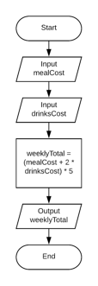
Component 3 Learning Aim D Planning and communication in digital systems D1 Forms of Notation
Flowcharts
Flowcharts
A flowchart is often a clearer way to present the steps required
​
They are easy to understand​
They are less likely to be misunderstood than a list of text
Flowchart Symbols
Variables in a flow chart
Variables allow us to store a number or ​ text in a flowchart​
Variables are often used in calculations​
Calculations will always be in a process box​
You can input or output what is stored ​ in the variable
Counting in a flow chart
The statement count = count + 1 means “Add 1 to the variable called count”
Real uses for flow charts
Companies will often create flowcharts to show what to do when a problem occurs, such as:
​
Fire procedures​
Customer complaints​
Manufacturing defects​
Companies may also have ​ procedures to help employees ​ to do their day to day work

Slide 3
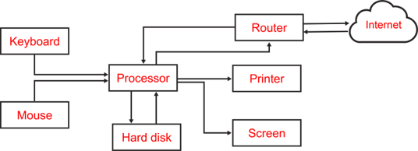
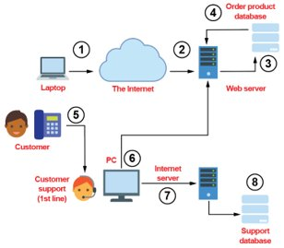
Component 3 Learning Aim D Planning and communication in digital systems D1 Forms of Notation
Systems Diagrams
Computer Systems
A computer system consists of all the hardware and software required to perform the required tasks
​
At its simplest, a computer system consists of input, processing and output
A Simple System Diagram
Other uses for Systems Diagrams
System diagrams can also ​be used for an organisation
System diagrams may use standard ​icons or be more informal​
You may choose to just ​use boxes with text inside
Drawing a systems diagram
Most IT system diagrams will include:
Hardware
Input / output devices​
Storage devices / databases​
Network equipment such as Wi-Fi access points​
Computers / Smartphones / Tablets​
People involved in the system can also be included​
Processes or events are described
Step 1: Identify the key components
Step 2: Draw the key parts
Step 3: Connections
Step 4: Label the diagram
Why use system diagrams?
They can give a lot of information in a small space:​
Input and output devices​
Connections between components and data or signals​
Computers / servers involved​
Communication devices​
Feedback loops​
They are a good way to communicate designs, infrastructure and processes about IT and an organisation’s systems​
They help in designing workable systems

Slide 4
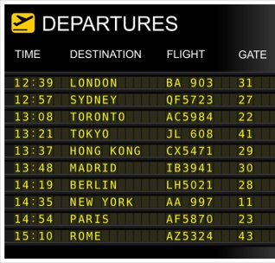
Component 3 Learning Aim D Planning and communication in digital systems D1 Forms of Notation
Tables and Written Information
Written information
Written information is good for giving further analysis of data.
Uses in business
Policies​
Catalogues​
Reports​
Emails​
Letters
Rules on writing:​
Write concisely​
Use appropriate language for your audience​
Check your writing for spelling, punctuation and grammar​
Include references and acknowledgements​
For long documents or business reports:​
Include page numbers and a contents page​
Include a summary
Tables
Tables are a useful way of presenting information​
How the data is presented in a ​table makes a difference to how ​easy it is to extract useful information​
Uses of tables:​
Timetabling​
Financial models​
Planning​
Survey results​
Flight departures / arrivals
Disadvantage:
A table may not be able to show all the​ required information
How to improve table design:
Giving the table a title​
Referencing the source of the data​
Including units for the speed​
Considering what data the ​audience needs​
Use formatting features to help ​the reader:​
Conditional formatting makes it easier​ to see the difference in speeds​
Bold column titles are clearer
Example Exam Question

