Slide 1
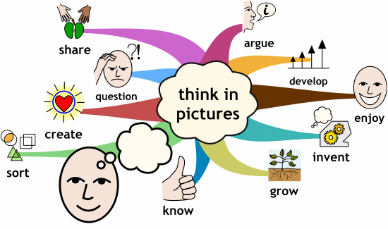
Component 3 Learning Aim A Mind Maps
Modern Technologies

Slide 2
Key Terms
Bluetooth ​
Ad hoc Network
Personal Area Network
Tethering
Personal hotspot
PIN
Encrypted
USB
Insecure
Streaming
A traditional network is…
An adhoc network is…
Issues affecting availability
Benefits​ of ad hoc | Drawbacks​ of ad hoc
Cloud storage is…
Availability of cloud storage:
What can be stored in the cloud?
Benefits​ of cloud storage | Drawbacks​ of cloud storage
Key Terms
Server
Downloading
Uploading
Synchronising

Slide 3
Two main ways of accessing online applications:
1.
2.
File sharing is …
Benefit​s of online applications | Drawbacks of online applications
Benefits of collaboration tools
Features affecting platform selection:
Considerations when selecting a cloud platform:
4 most common platform types:
Key Terms
Stakeholders
Downtime
Geo-data

Slide 4
Key Terms
Synchronisation
Synchronisation is …
Why is synchronization required?
What is the difference between online and offline working?
How to connect to the internet when no Wi-Fi connection is available.
A disaster recovery policy is …
Possible disasters
Data security when using cloud computing…
Benefits​ of disaster recovery policies | Drawbacks​ of disaster recovery policies

Slide 5
Key Terms
Virtual machines
Systems administrator
Spam
Downtime is …
Benefits of collaborative technologies
Benefits​ of cloud technologies | Drawbacks​ of cloud technologies
Collaborative technologies…
Examples of Collaborative technologies…
Key Terms
Version control
Version control is …

Slide 6
Key Terms
URL
A stakeholder is …
Benefits of using collaborative and communication software to manage teams
Channels for communication
Benefits of using scheduling and planning software to manage teams:
Private Communications | Public Communications

Slide 7
Key Terms
ALT Text
Inclusivity is …
Accessibility tools include:
Benefits​ of distributed data | Drawbacks​ of distributed data
Impacts of infrastructure on an organisation:​
​
Distributed data is…
Infrastructure is…
Dispersed data is…
Key Terms
Distributed data
Dispersed data

Slide 8
Benefits and drawbacks for customers of 24/7 access​
Benefits​ | Drawbacks​
Benefits and drawbacks for organisations of 24/7 access​
Benefits​ | Drawbacks​
Benefits to an organisation of remote working:
Drawbacks to an organization of remote working:
Key Terms
Wiki
Benefits to an individual of remote working:
Drawbacks to an individual of remote working:
What is remote working?

