Slide 1
Amnesty Feast Stall
Book and Movie recommendations about refugee stories to support
#RefugeeWeek #SimpleActs

Slide 2
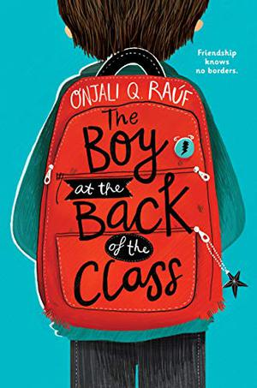
The Boy at the Back of the Class (4.8 stars)
When a new boy joins their class, a group of children try to befriend him. They soon learn that Ahmet is a refugee and has been separated from his family. None of the grown-ups seem to be able to help him, so the friends come up with a daring plan, embarking on an extraordinary adventure.
“This was one of the best books I have read in a long time! I would recommend this book for 9-13 year olds. 5 stars”
“I was just reading it for my school homework. So amazing. The plot is great. Worth the read. 5 stars.”

Slide 3
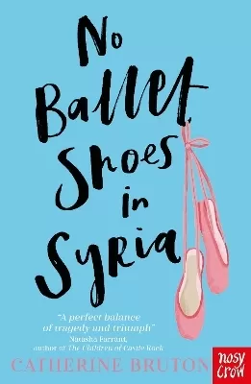
No Ballet Shoes in Syria (4.9 stars)
Aya is a Syrian asylum seeker, looking after her mother and baby brother in the cold, unfamiliar city of Manchester – but she is also a talented ballet dancer. A part of her life that seemed lost forever when she fled her home comes back to her when she encounters a ballet class led by the elegant Miss Helena.
This book was a moving story about one of the big issues of our time, and incredibly touching. 5 stars. Age 9-11.”

Slide 4
Out of the Hitler Time (4.7 stars)
Anna was a German child when she had to flee from the Nazis before the War. By the time the bombs began to fall she was a stateless adolescent in London, and after it was all over she became a happily married Englishwoman who thought she had put the past behind her. This book contains three books by Judith Kerr; When Hitler Stole Pink Rabbit, Bombs on Aunt Dainty and A Small Person Far Away.“If you want to learn more about real WWII stories these are the best. Ages 10+. 4.5 stars.”

Slide 5
After the War (4.7 stars)
Summer 1945. The Second World War is finally over and Yossi, Leo and Mordecai are among three hundred children who arrive in the English Lake District. Having survived the horrors of the Nazi concentration camps, they’ve finally reached a place of safety and peace, where they can hopefully begin to recover. Will life by the beautiful Lake Windermere be enough to bring hope back into all their lives?
"The best children's fiction book I've yet read about the Holocaust." (Tim Robertson, CEO of Anne Frank Trust UK)

Slide 6
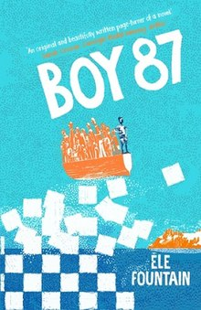
Boy 87 (4.7 stars)
This gripping novel takes you on a journey. A boy Shif ( who is a refugee) tries to make it safely over to England. If you read other books like refugee boy or illegal you are sure to enjoy this. I recommend ages from 9- 13. Ele fountain you have done a good job
Boy 87 tells the story of immigrants trying to flee to Europe through the eyes of Shif, an innocent and unknowing eleven-year-old boy. This heart breaking book perfectly captures the often-overlooked struggles of refugees throughout the world as well as addressing the catastrophic greed in it caused by money.
“This gripping novel takes you a journey. A boy Shif ( who is a refugee) tries to make it safely over to England. If you read other books like refugee boy or illegal you are sure to enjoy this. I recommend ages from 9-13. Ele fountain you have done a good job. 4.5 stars”

Slide 7
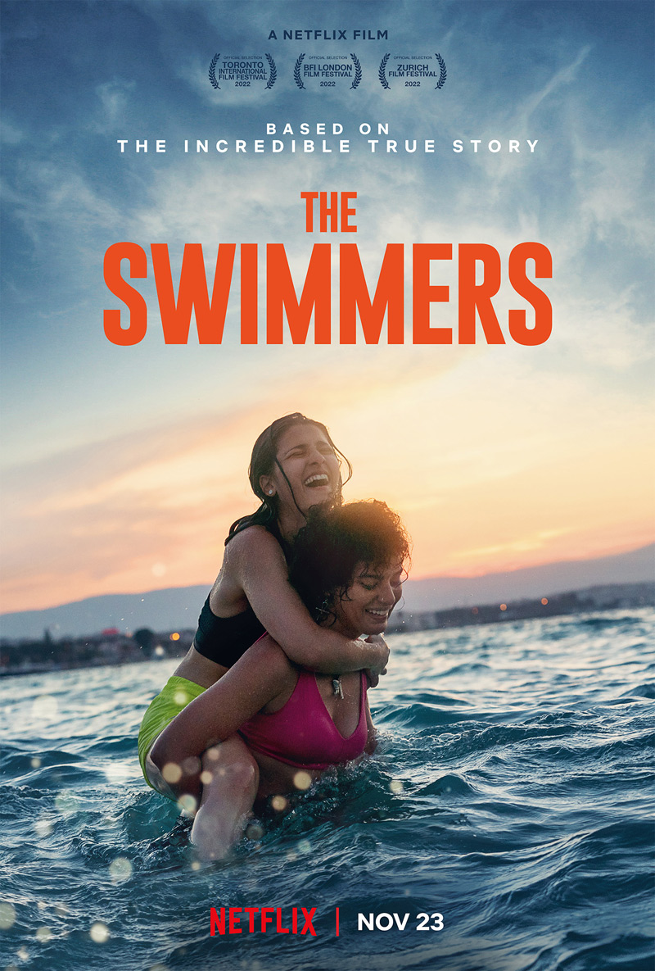
The Swimmers - PG 13 - 4.2 stars
Syrian sisters flee their war-torn home in Damascus, they swim for hours in choppy mediterranean seas to reach Greece as asylum seekers before going on to compete at the Rio Olympic Games. You can watch this on Netflix.

Slide 8
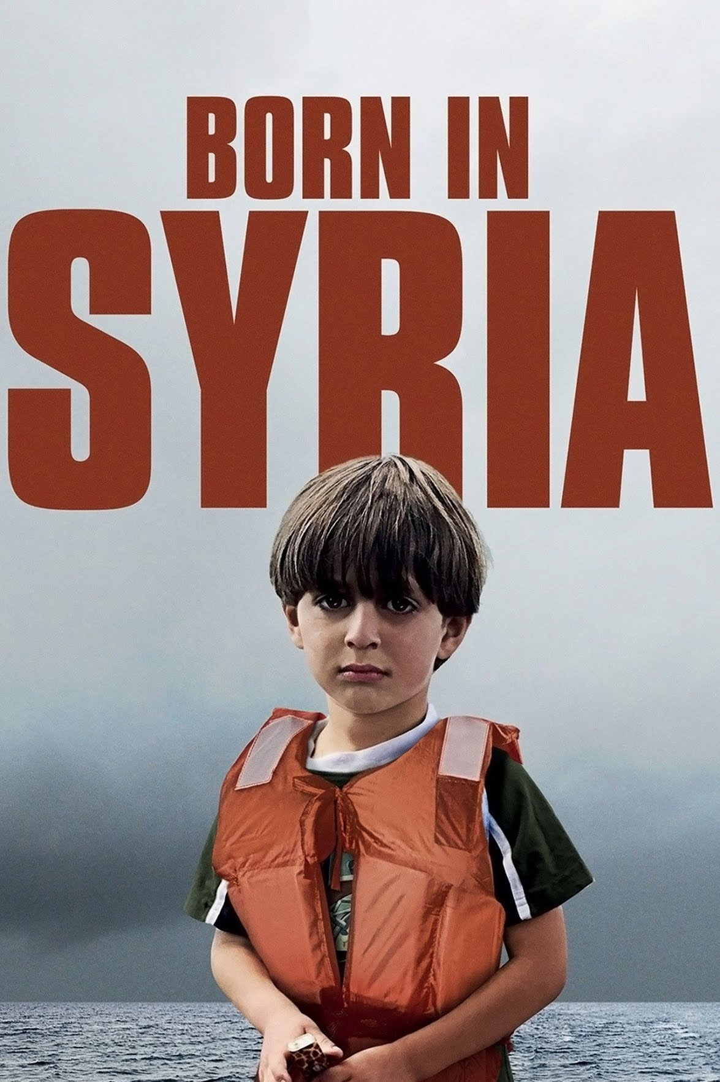
Born in Syria - PG - 4.7 stars
Since the beginning of civil war in 2011, an estimated 9 million Syrians have fled their homes, half of them children. These children flee unimaginable horrors in hopes of finding refuge in Europe. This can be seen on Netflix.

Slide 9
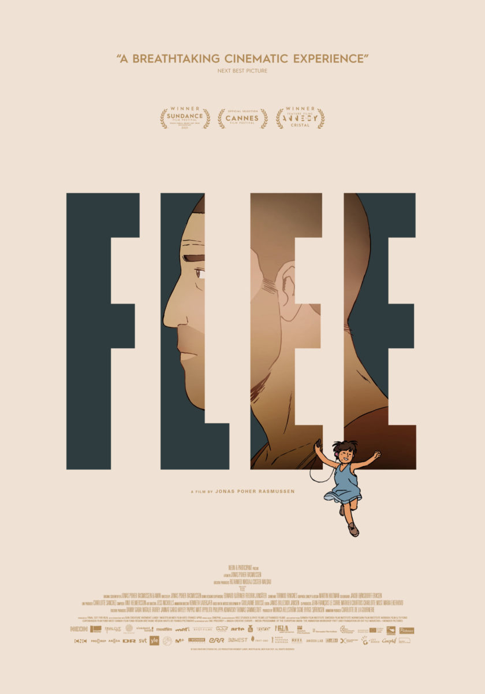
Flee - PG 13 - 4.5 stars
FLEE tells the extraordinary true story of a man, Amin, on the verge of marriage which compels him to reveal his hidden past for the first time. An animated documentary telling the true story about a man's need to confront his past in order to truly have a future. It is recommended by multiple people.Recounted mostly through animation to protect his identity. Hulu, Disney+, and ESPN+ all have flee.

Slide 10
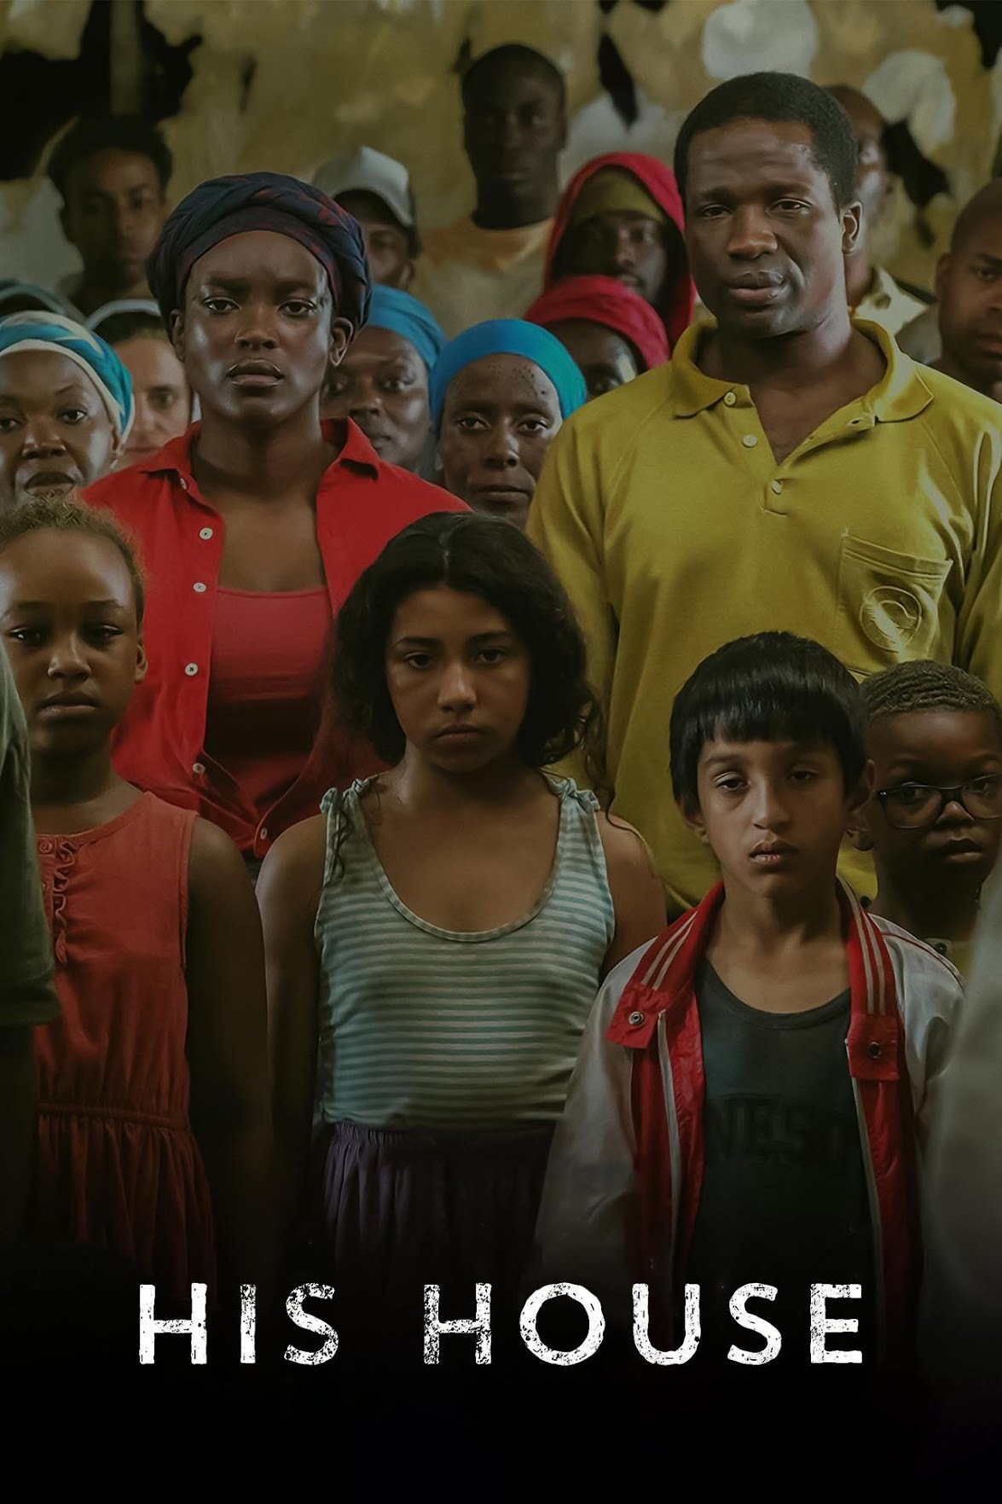
His House - 15 - 4.2 stars
His House is a 2020 horror thriller film written and directed by Remi Weekes from a story by Felicity Evans and Toby Venables. It stars Wunmi Mosaku, Sope Dirisu and Matt Smith. The film tells the story of a refugee couple from South Sudan, struggling to adjust to their new life in an English town that has an evil lurking beneath the surface. It can be seen on netflix.

Slide 11
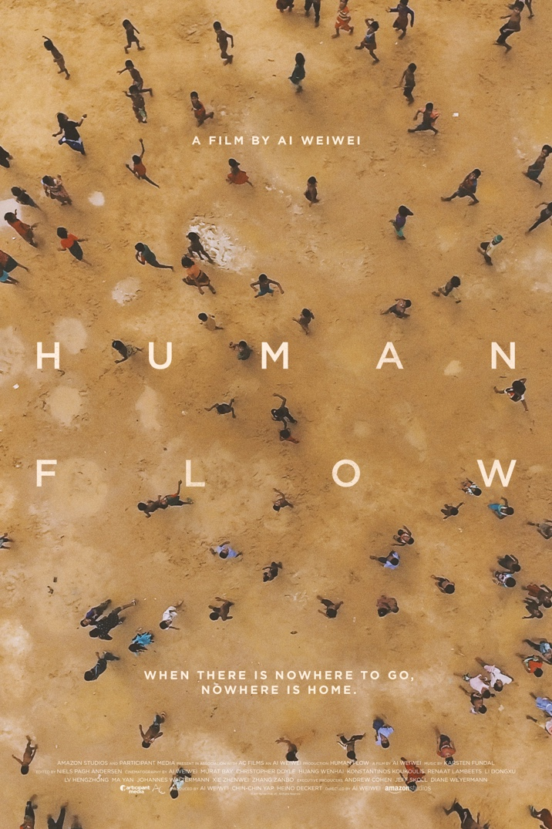
Human Flow - PG 13 - 4.7 stars
Human Flow is a 2017 German documentary film co-produced and directed by Ai Weiwei about the current global refugee crisis. In the film the viewer is taken to over 20 countries to understand both the scale and the personal impact of this massive human migration.

Slide 12
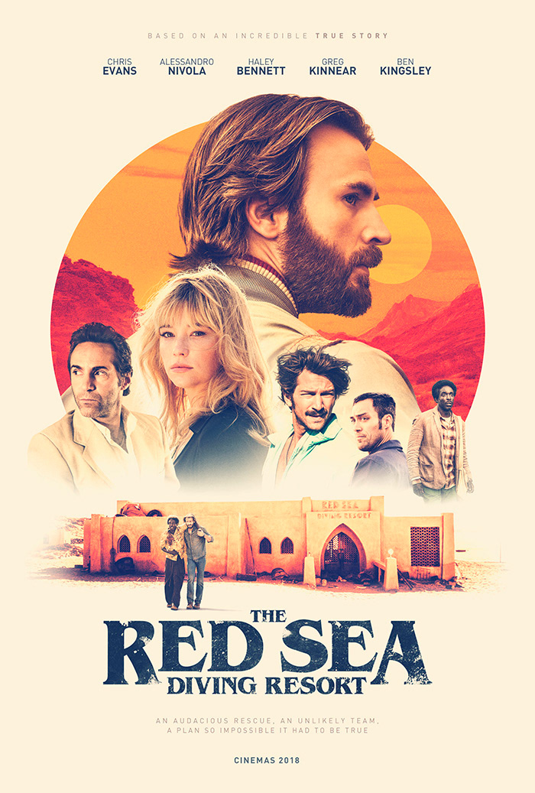
The Red Sea - 14+ - 4.5 stars
A truly inspiring true story based on the Israeli government’s attempt to get refugees out of the Sudan. The plan centers around using the Red Sea diving resort as a cover, sneaking the refugees out at night to awaiting naval ships. While the real life story is quite amazing, the movie seems a bit lackluster. The age rating on this video is 14+ and you can find it at amazon video, google play movie and youtube.
=

